Slide 1

IST 261 (Fall 2019)
Application Development Design Studio I
JVM
Phil O'Connell
pxo4@psu.edu

Slide 2
Portability
Before virtual machines were invented, programs had a drawback
A compiled program only ran on one platform
If I wanted it to run on a different platform, I would need to modify/recompile it there
Meaning, the program was not easily portable
It would be nice if I only had to write it once, and it would run anywhere
That is accomplished via the JVM

Slide 3
The Java Virtual Machine (JVM)
Java Virtual Machine
It is an app built according to specifications on how to read/run Java bytecode (.class file)
Every system wanting to run Java has a JVM
The bytecode runs in the JVM
It doesn't matter what system the JVM is on
Mac, PC, Linux, Android, OS X
All JVMs can run the same bytecode files
i.e., .class files and .jar (zipped .class files)
Note: iOS does not allow JVMs

Slide 4

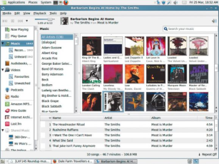
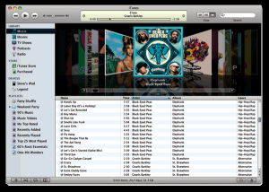
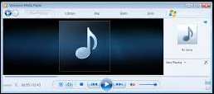



A JVM is Like an MP3 Player
The same MP3 file can be played on many players
Each player adheres to the MP3 file specifications
It doesn’t matter what system created the MP3 file
iTunes
Banshee (Linux)
Windows Media Player

Slide 5


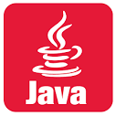
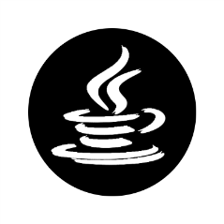
Java bytecode Runs on any JVM
The same .class file can be run on any JVM
Each JVM adheres to Java bytecode specifications
It doesn’t matter what system created the .class file
HelloWorld.class
Linux JVM
Windows JVM
OS X JVM

Slide 6
Life Cycle of a C Program
Compare C's life cycle to a Java's
Java is much more portable than C
A C program is compiled into assembly code
Then assembled into an executable (.exe)
Both assembly and executable can only be used on the type of machine you built them on
So, if I compiled HelloWorld.c on an Apple computer, and on a PC...

Slide 7
HelloWorld in C on a Mac
Creating HelloWorld on a Mac
C source code
#include <stdio.h>
int main(void) {
printf("Hello, world!\n");
return 0;
}
Mac Assembly
.or $300
main ldy #$00
.1 lda str,y
beq .2
jsr $fded
iny
bne .1
.2 rts
str .as "Hello, world!"
.hs 0D00
compile
This will not run on a PC!
assemble
helloworld
0101111100011101001010111010100011100100101001011011000100…

Slide 8
HelloWorld in C on a PC
Creating HelloWorld on an old PC
C source code
PC Assembly
#include <stdio.h>
int main(void) {
printf("Hello, world!\n");
return 0;
}
org 100h
mov ax, 0b800h
mov ds, ax
mov [02h], 'H'
mov [04h], 'e'
mov [06h], 'l'
mov [08h], 'l'
mov [0ah], 'o'
mov [0ch], ','
mov [0eh], 'W'
mov [10h], 'o'
mov [12h], 'r'
mov [14h], 'l'
mov [16h], 'd'
mov [18h], '!'
c: mov [di], 11101100b
add di, 2
loop c
ret
compile
This will not run on a Mac!
assemble
helloworld.exe
10011010001011101010001010010111101010010100101111001111000…

Slide 9
HelloWorld in Java on Any System
Creating HelloWorld on any computer
Java source code
HelloWorld.class
public class HelloWorld {
public static void main(String[] args){
System.out.println("Hello world!");
}
}
...
const #18 = Asciz Hello world!;
...
public HelloWorld();
Code:
Stack=1, Locals=1, Args_size=1
0: aload_0
1: invokespecial #1;
4: return
LineNumberTable:
line 1: 0
public static void main(java.lang.String[]);
Code:
Stack=2, Locals=1, Args_size=1
0: getstatic #2;
3: ldc #3;
5: invokevirtual #4;
8: return
javac
Runnable in any JVM: Windows, Mac, Linux
JVM
It will a different binary for each operating system, because each O/S has its own specialized JVM
JIT compiler
01011101010001010010111101010010100101111001111000…
Just In Time

Slide 10
More About Java byetcode
The JVM uses the bytecode
But it has no idea what created that bytecode
Most of the time, it will be javac compiling Java code
If you wanted, you could invent your own language
As long as you can convert it to bytecode that a JVM can run
And such languages do exist:
Clojure, Groovy, JRuby, Jython, Kotlin, Scala
https://en.wikipedia.org/wiki/List_of_JVM_languages

